Slide 1
PHEROMONES

Slide 2
DEFINITION OF PHEROMONES
Pheromones are types of chemicals that are released by organisms as a means of communication with organisms of the same species.
Pheromones are species specific & produced by exocrine glands.
Some animals release it through their urine, their skin or even in their feces, and it is detected using smell.
Pheromones can be released for a variety of reasons including readiness to mate, an alert to danger, showing a certain territory or even when an animal is ovulating.

Slide 3
HISTORY
Hediger (1944) first reported the significance of odour in communication,this specialized communication includes smell or scent & pheromones.
Earlier these chemicals were referred to as ectohormones but in 1959 Karlson & Luscher coined the term “pheromone” for it.
Allochemics is the term given to those chemical signals that convey information between members of two different species.

Slide 4
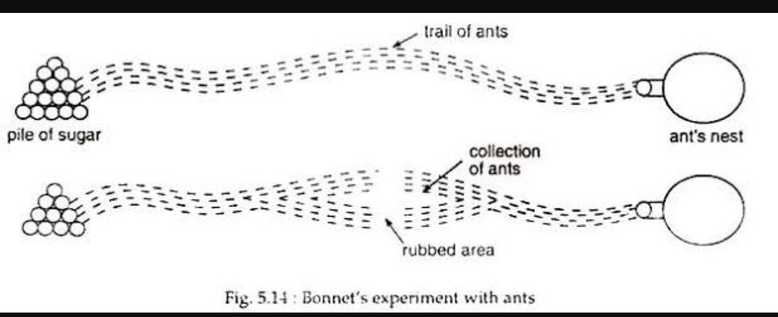
DISCOVERY OF PHEROMONES

Slide 5
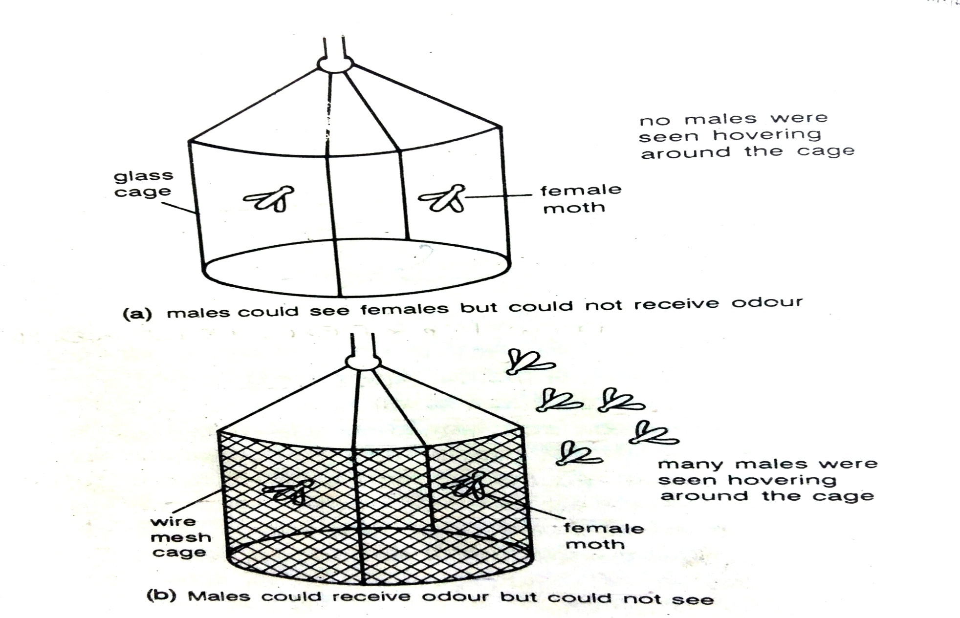
JEAN HENRI FABRE’S EXPERIMENT

Slide 6
FACTS ABOUT PHEROMONES
Pheromones are similar to hormones but work outside of the body.
They induce activity in other individuals, such as sexual arousal.
Most insects use pheromones to communicate.
Some chemicals have been investigated for pheromone actions in humans but evidence is weak.

Slide 7
FUNCTION
Animals secrete pheromones to trigger many types of behaviors including :
raising an alarm
signaling a food trail
triggering sexual arousal
tell other female insects to lay their eggs elsewhere
delineating a territory
bond between mother and offspring
warning another animal to back off

Slide 8
TYPES OF PHEROMONES
Bruce (1970) had recognized following three main types of pheromones:-
Releaser pheromones
Primer pheromones
Imprinting pheromones

Slide 9
RELEASER PHEROMONES
Releaser pheromones are powerful attractant molecules that some organisms may use to attract mates from a distance of two miles or more.
This type of pheromone generally elicits a rapid response but is quickly degraded.
In contrast, a primer pheromone has a slower onset and a longer duration.
Example : Rabbit (mothers) release mammary pheromones that triggers immediate nursing behavior by their babies.
Releaser pheromones used mainly in recognition of species members, sex, sexual status, aggression, ejection of milk,etc.
Examples-
Sex pheromones Aggregation pheromones Anti-aggregation pheromones Alarm pheromones | 5. Recruitment pheromones 6. Trail following pheromones 7. Territory marking pheromones and many others

Slide 10
PRIMER HEROMONES
Primer pheromones induce modification of the emotional state and are beneficial as an adjunct to other forms of behavior therapy and environmental modification.
Primer pheromones, such as facial, interdigital, and appeasing pheromones, induce delayed effects that are modulated through the activation of the neuroendocrine limbic system, including the amygdala, the fear and emotional control center of the brain.
Example :- Pheromones involved in suppression & induction of estrous cycle, termination of pregnancy & sexual menstruation cycle.
Lee & Boot effect- Pseudopregnancies in female mice
Bruce effect or pregnancy block in female rodents
Whitten effect
Regulation of caste system & size of the colony in termites.
Queen honeybee preserves her monarchy by exuding a pheromone called queen substance.

Slide 11
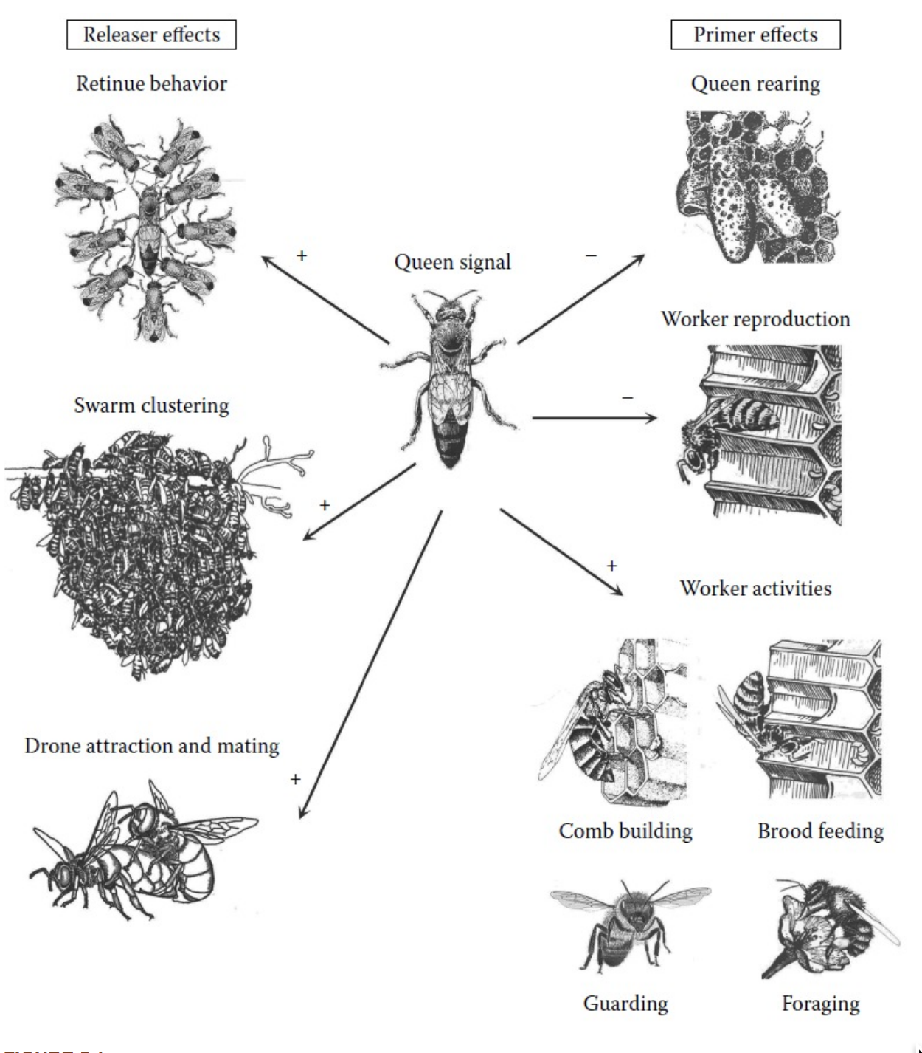
RELEASER & PRIMER EFFECTS

Slide 12
IMPRINTING PHEROMONES
Imprinting pheromones organize the cenfral nervous system of the preweaning offspring's at a critical period that cause permanent alterations of adult behaviour.
Example :
Mice
Rats

Slide 13
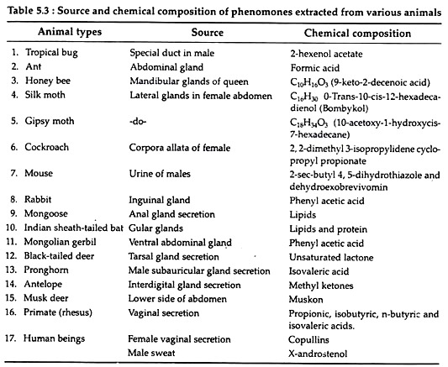
SOURCE & CHEMICAL COMPOSITION OF PHEROMONES

Slide 14
PHEROMONES IN INVERTEBRATES
Glands producing pheromones
Pheromones of orthoptera (locusts & cockroaches)
Pheromones of Lepidopterans (butterflies & moths)
Pheromones of hymenoptera (honeybees & ants)
Structures Perceiving Pheromones

Slide 15
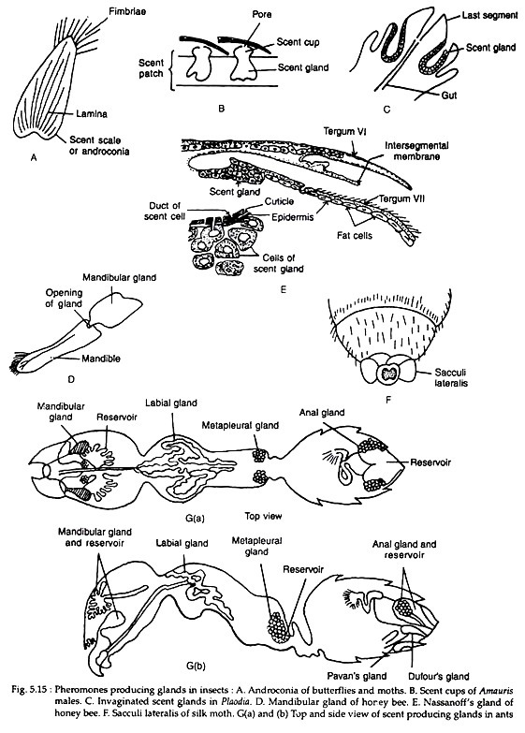
PHEROMONES PRODUCING GLADS

Slide 16
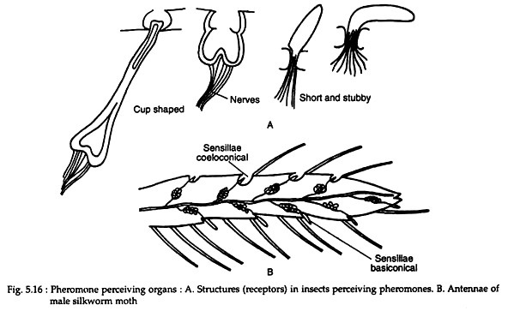
PHEROMONE PERCEIVING ORGANS

Slide 17
FUNCTIONS OF INSECT PHEROMONES
Insects pheromones as sex attractants:-
(a) Pheromones attracting males:-
Ex- Queen bee attract drones
Male emperor moth Endiapavonia can detect the sex attractant of the female as far as 13 km.
(b) Pheromones attracting females:-
Ex- Male beetle Harpobittacus

Slide 18
PHEROMONES OF SOCIAL INSECTS
1 Communication
  Many ant species lay scent trails.
  Alarm pheromones among social insects have three main functions-
    to alert the colony
    to release aggression
    to mark the target to be attacked
  Worker bees are attracted to each other, by a scent from nasanoff’s gland at the time of feeding, formation of new hive, to mark a source of water, to mark hive for recognition etc.
2 Maintenance of colony structure

Slide 19
PHEROMONES IN VERTEBRATES
In Reptiles
Chemical trails are left behind by female garter snake which the male follows.
The female snake, while moving, pushes against one side of certain objects and leaves behind scent in her direction of tra­vel.
The male snake tests each side of these objects with its forked tongue and recognises which side the female has pushed against.

Slide 20
PHEROMONES IN VERTEBRATES
In Mammals:
Markings with urine and faces:
Scent marking by special glands:
    Anal glands
    Salivary glands
    Miscellaneous glands

Slide 21
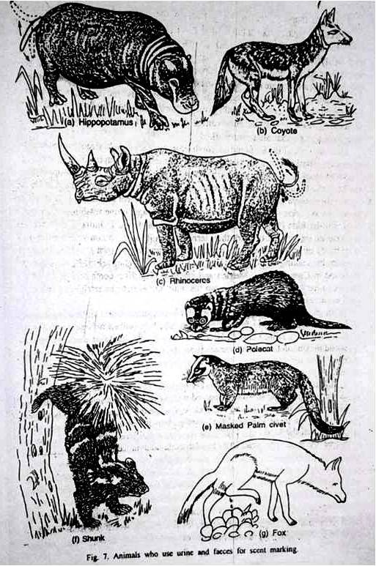
USE OF URINE & FACES

Slide 22
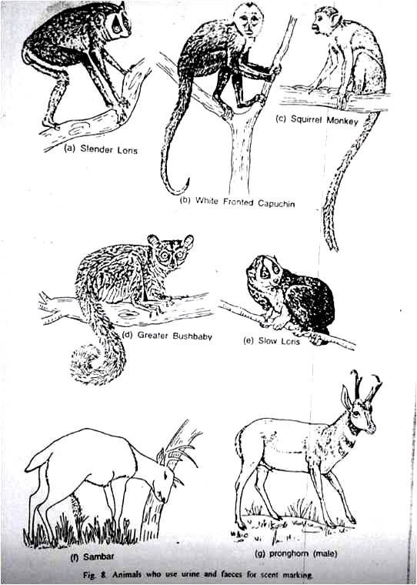
USE OF URINE & FACES

Slide 23
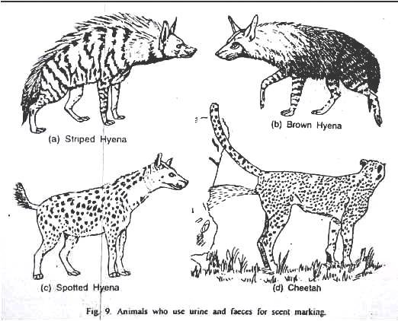
USE OF URINE & FACES

Slide 24
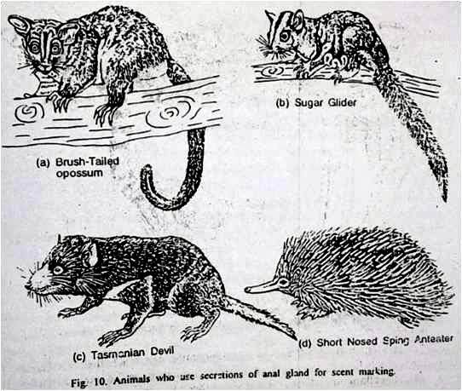
UEE OF SPECIAL GLAND : ANAL GLAND

Slide 25
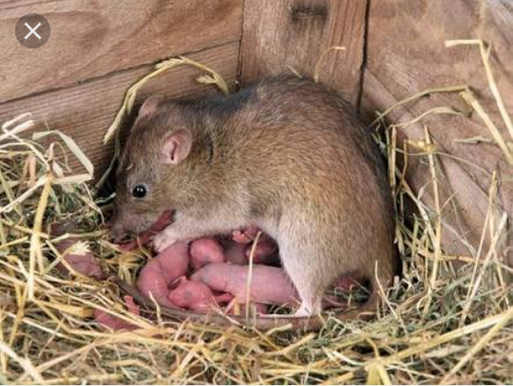
SALIVARY GLANDS

Slide 26
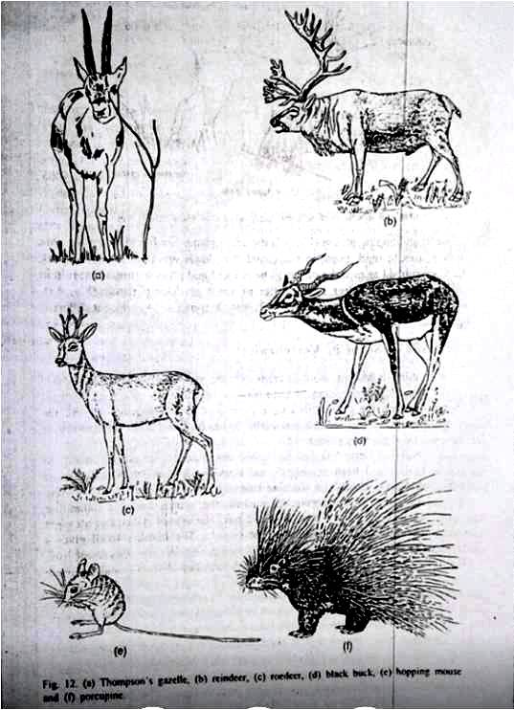
MISCELLANEOUS GLANDS

Slide 27
FUNCTIONS OF PHEROMONES IN VERTEBRATES
Scent marking provides sense of belonging
Enhancement of self confidence
Regulation of sexual behaviour
Trail marking
Territorial marking helps in avoiding recurring fights
Sometimes males mark their mates with scent
A wildebeest sniffs her newborn to form a permanent olfactory bond with her offspring.
Sniffing a genitalia is a common sight in ready to mate animals
Pheromones avoids inbreeding

Slide 28
THANK YOU

